Slide 1
Section 7.8 Natural Logarithms
© Copyright All Rights Reserved Homework Depot www.BCMath.ca

Slide 2
What is Natural Log?
A “Natural Logarithm” is a logarithm when it has a base of “e”
“e” is known as “Euler’s Number” and is used in situations involving continuous growth/decay in an exponential scenario
Compound Interest with “n” compounds in a year
Continuous Compound
Euler’s Number “e”
(Irrational)

Slide 3
Evaluating Natural Logarithm?
Most calculators have a natural log button that evaluates natural logs
When simplifying or evaluating natural logs, the same log rules apply
Ex: Evaluate the following:
© Copyright All Rights Reserved Homework Depot www.BCMath.ca

Slide 4
Ex: Evaluate each of the following natural logs without a calculator

Slide 5
Solving Equations with natural Logs:

Slide 6
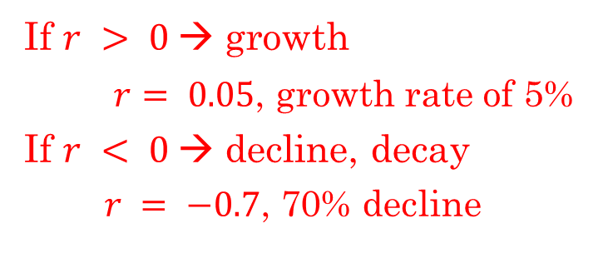
What is “euler’s Number ‘e’?
The value of “e” was discovered in 1683 by a swiss mathematician name Jacob Bernoulli
He was studying compound interest, the effects of compounding infinitely many times within a year
Continuous Compound
Compound Interest:
What would happen if
If $r > 0$→ growth
$r= 0.05$, growth rate of 5%
If $r < 0$→ decline, decay
$r = −0.7$, 70% decline
n: The number of compounds in a year
e= 2.7182818284590452353602874713527……
If you replace “n” with a very large number, the value of this equation will get closer to the true value of “e”

Slide 7
Ex: An investment policy pays an interest rate of 100% for one year. If one dollar is invested and the number of compounds in a year increases, how much will be accumulated?
Number of Compounds
© Copyright All Rights Reserved Homework Depot www.BCMath.ca

Slide 8
As the number of compounds goes to infinity, the formula changes:
Whenever we have continuous compounding, we use this formula, and a base of “e”
“A” – accumulated amount that is accumulated after the compound period, including the principal
“P” – principal, the initial amount of money that is invested
“r” – the percentage increase or decrease in decimal form
If investment increases by 4% annually then r = 0.04
If investment decreases by 3% annually then $r = − 0.03$
“t” – the number of years of investment

Slide 9
Ex: The population of a particular country is 32 million. Assuming the population is growing continuously at a rate of 2.7%, find the population P, in millions, 20 years from now.
Ex: Japan has a population of 125.7 million in 2023 and has a decline rate of 0.7%. Without government intervention, the population of Japan will continue to decline at a rate of 0.7%. What will Japan’s population be in 2033?

Slide 10
Japan, Russia, and Bulgaria are three countries with a negative population growth rate. Japan – low fertility rate, Russia – low fertility and aging population, Bulgaria – low birth rate and emigration.
i) Calculate the rate of population growth for each of these countries.
ii) If the rate continues, what will the population of these countries be in 2050?
a) Japan population in 2011: 127,799,000. April 2025: 123,217,752
b) Russia population in 2021: 147,200,000. April 2025: 143,800,000
c) Bulgaria population in 1989: 9,009,018. April 2025: 6,722,009

Slide 11
a) Japan population in 2011: 127,799,000. April 2025: 123,217,752
First step is to gather all the information given
The population of Japan is decreasing at a rate of 0.261% annually
Initial population is 127,799,000
Final population is 123,217,752
Base is “e” [continuous compounding]
In 25 years the population will be:
Use the difference in years to find “t”: t = 14 years
Use all this to find the rate of change “r”
If the population continues to decrease at the same rate, the population of Japan in 2050 will be around 115.4 million

Slide 12
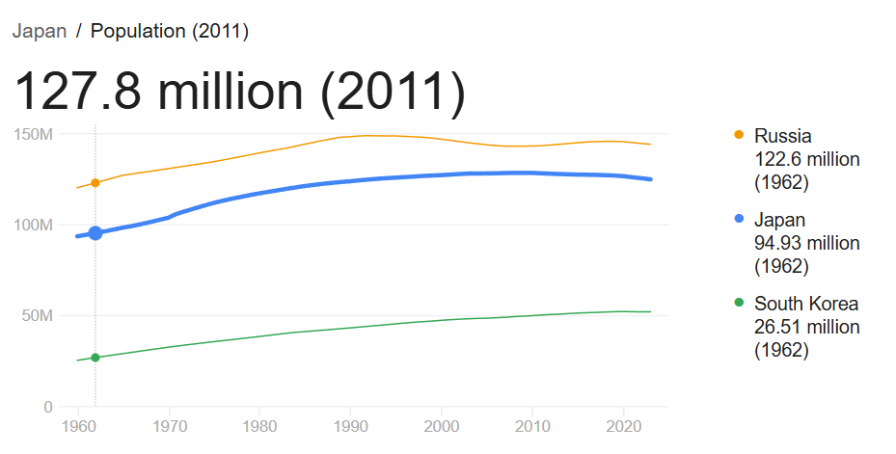

Slide 13
b) Russia population in 2021: 147,200,000. April 2025: 143,800,000
Find the population in 25 years
If the population of Russia continues to decline at the same rate, it’s population in 2050 will be around 124.259 million

Slide 14
c) Bulgaria population in 1989: 9,009,018. April 2025: 6,722,009
Find the population in 25 years
If the population of Bulgaria continues to decline at the same rate, it’s population in 2050 will be around 5.015 million

Slide 15
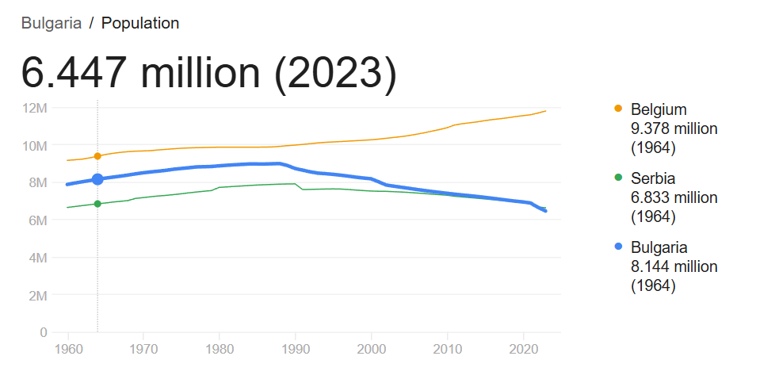

Slide 16
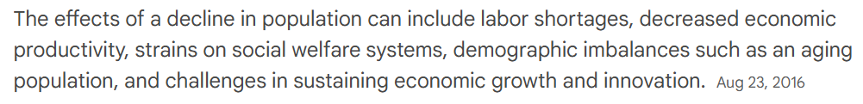
A declining population in a country raises significant concerns, primarily related to economic instability, social changes, and potential challenges for the future. These concerns include a shrinking workforce, a larger elderly population straining social security systems, reduced tax revenue, and diminished innovation due to fewer young people

Slide 17
1. Economic Impacts:
Shrinking Workforce:
A smaller working-age population means fewer people to contribute to the economy through labor and taxes, potentially leading to slower economic growth.
Increased Dependency Ratio:
As the elderly population grows relative to the working-age population, the strain on social security systems, healthcare, and retirement programs increases.
Reduced Tax Revenue:
Fewer workers mean less income tax revenue for the government, potentially leading to budget deficits and difficulties in funding essential services.
Deflation:
A declining population can lead to decreased demand for goods and services, potentially causing deflation and making it difficult for economies to recover from downturns.
Stagnant or Declining GDP:
Population decline can negatively impact economic growth, as a smaller workforce and fewer consumers lead to lower overall production.

Slide 18
2. Social and Cultural Impacts:
Loss of Culture:
A shrinking population, particularly if it's accompanied by emigration, can lead to a loss of cultural diversity and traditional practices.
Strain on Mental Health:
Permanent recession and a decline in social services can negatively impact mental health and morale.
Aging Population:
A larger elderly population can create challenges for end-of-life care and social support, potentially straining healthcare systems.
Increased Competition for Resources:
A declining population can exacerbate issues related to resource scarcity and competition, potentially leading to conflict

Slide 19
3. Long-Term Consequences:
Decline in Innovation:
A shrinking young population can lead to a decline in innovation and new ideas, hindering long-term economic and social progress.
Decreased Military Strength:
A smaller population can also lead to a reduction in the military-age population, potentially weakening a country's defense capabilities.
Imbalance in Social Structure:
An aging population can lead to an imbalance in the social structure, potentially creating tensions between generations.

Slide 20
Applications of Continuous Compounding
Many events in the real world compound on a continuous rate
ie: Compounded by the second, millisecond,…etc
Each compounding period becomes infinitely small
Finance – national debt
RULE of 72 – time it takes for an investment to double
Population growth/decline in a country
babies born any second (day/night)
Immigration
Radioactive Decay
Carbon 14 decays at a continuous rate
Does not lose a fixed weight in a single compound of several thousand years
© Copyright All Rights Reserved Homework Depot www.BCMath.ca

Slide 21
Ex: Joe invested $500 in a fund that gave an annual return rate of 4% and is compounded continuously. How long will it take Joe’s investment to double?
Ex: If Joe’s investment increase the annual rate of return to 8%, then how long will it take his investment to double? Triple? Quadruple
Ex: If the half life of a radio active substance is 1000 years, what is the rate of decay?

Slide 22
Ex: The population of Thailand in 2007 is 63 million and is growing at a rate of 1.2% annually. Assuming the country’s population is continuously growing, in how many years will the population be 120 million?
Practice: The population of metro-Vancouver in 2008 is at 2.25million. If the population continues to grow at a continuously compounding at a rate of 1.5%, when will the population to reach 3.5 million?
Practice: An radio-active substance was weighed in two separate times 120 seconds apart. First measurement weighed 500g, second measurement weighed 115g. If a 3rd measurement was weighed 60s after the 2nd measurement, how many grams will the substance weigh?

Slide 23
Ex: James invests in a fund that compounds continuously at a rate of 4.5% for 7 years. Tom invests in a bank where interest is compounded monthly. At what interest rate would Tom need to have to get the same return at James?
ii) The formula for the weight (W) of a radioactive substance after “t” seconds, is given by the formula below. Where ‘P” is the initial weight (grams). What is the half life of the substance?
iii) The half life of c-14 is 5570 years. The equation for the mass of C-14 after “t” years is given by the formula below. Find the value of “k”. What is the weight of 2000g of C14 after 1900 years?

Slide 24
Ex: The population of Thailand in 2007 is 63 million and is growing at a rate of 1.2% annually. Assuming the country’s population is continuously growing, in how many years will the population be 120 million?
In 2061ad, (54 years) the
population of Thailand will
reach 120 million people if the
rate of growth continues.
© Copyright All Rights Reserved Homework Depot www.BCMath.ca

Slide 25
Practice: The population of metro-Vancouver in 2008 is at 2.25million. If the population continues to grow at a continuously compounding at a rate of 1.5%, when will the population to reach 3.5 million?
In 2038ad, (30 years) the
population of Vancouver will
reach 3.5 million people if the
rate of growth continues.
© Copyright All Rights Reserved Homework Depot www.BCMath.ca

Slide 26
Natural Log Rules:
Log rules from section 2.3 also apply with Natural logs
© Copyright All Rights Reserved Homework Depot www.BCMath.ca

Slide 27
Practice: Which of the following expressions is equal to the following:
ii) Which of the following is equal to:
iii) Solve for “t”
iv) Solve for “x”
© Copyright All Rights Reserved Homework Depot www.BCMath.ca

